Slide 1


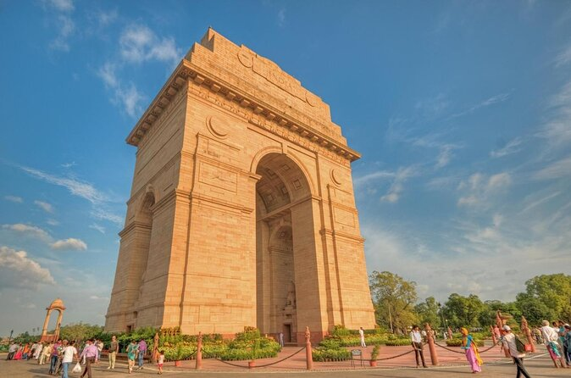
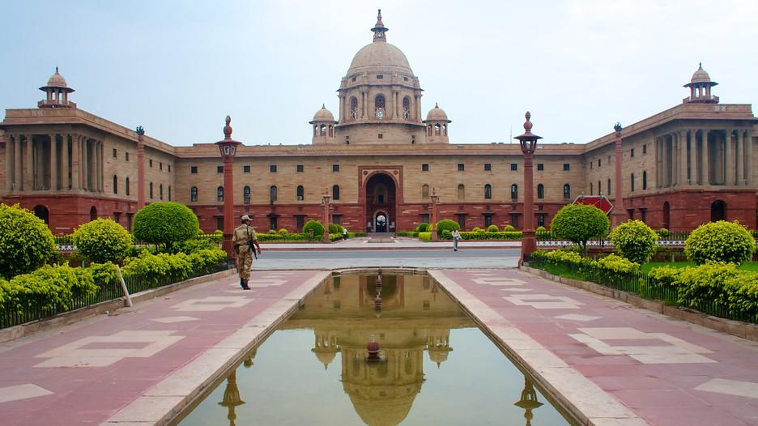

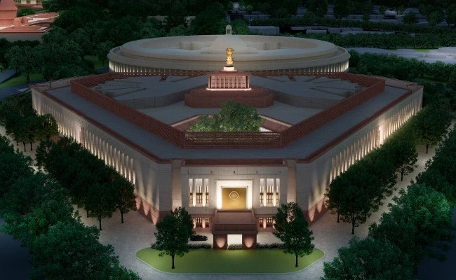
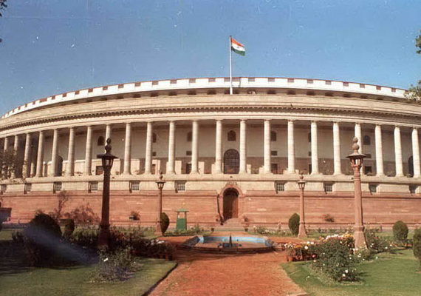
PRAVRITTI’25: A Talk
by Sanrachna Prahari Pvt Ltd
Sanrachna Prahari Pvt Ltd
An IIT Delhi Company
Connect with us on LinkedIn
www.spplindia.org

Slide 2
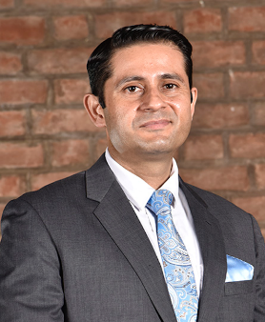
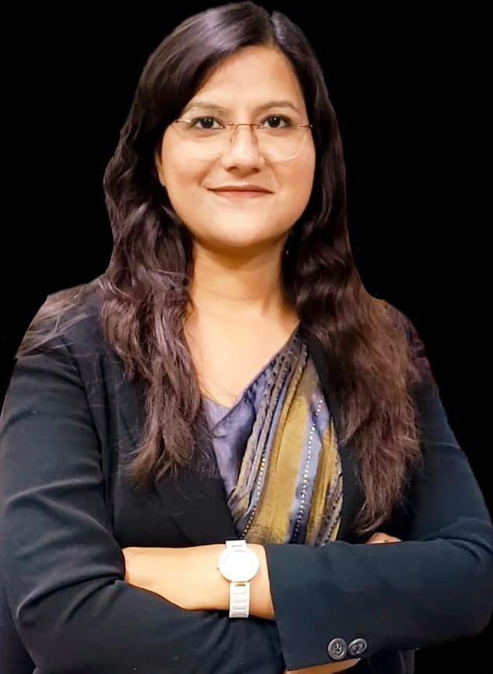
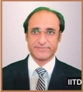
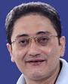
The Team: Business & Technology
Col Rohit Gogna (Retd)
IIT Delhi Alumni
CEO
Sanrachna Prahari
Dr Shipra Prakash
IIT Delhi Alumni
Director Operations
Sanrachna Prahari
Prof Suresh Bhalla
IIT Delhi
Head of SHM Sanrachna Prahari
Prof Alok Madan
IIT Delhi
Head of AI
Sanrachna Prahari
Area of Expertise of SPPL: Automated Online Structural Health Monitoring (Smart Cities, Tall Buildings, Strategic Structures, Mobile & Transmission Towers, Bridges, Tunnels, Refineries, Underground Structures and Heritage Structures) And Retrofitting Strategies

Slide 3
Proposal
JOB PROFILE: Software Development Engineer (INTERN)
INTERNSHIP DURATION: 2 MONTHS
STIPEND: 50,000/- (Paid after completion of task after 2 months as lumpsum amount).
CERTIFICATION: Provided by Sanrachna Prahari Pvt Ltd in Collaboration with Department of Civil Engineering, IIT Delhi.
OFFICE ADDRESS: 2-A-2G, RESEARCH AND INNOVATION PARK, IIT DELHI CAMPUS.
OFFICE TIMINGS: FLEXIBLE TIMINGS (at least one hour in between 10 A.M. to 7 P.M.)
FUTURE PROJECTION: Candidate will get preference in Hiring Process after Completion of their Course at IIT Delhi

Slide 4
Proposal
JOB DESCRIPTION
Develop and maintain the software framework (SaaS Model) for the Structural Health Monitoring System.
Design and implement algorithms for data collection, processing, and analysis from various sensors.
Integrate IoT-based sensors and devices for real-time monitoring of structural health.
Develop a cloud-based/web-based dashboard for visualization, alerts, and reporting.
Ensure scalability, security, and robustness of the SHM system.
Collaborate with civil engineers, data scientists, and hardware engineers to optimize monitoring capabilities.
Implement artificial intelligence and machine learning models (AI/ML) for predictive maintenance and anomaly detection.
Conduct system testing, debugging, and performance optimization.
Maintain proper documentation, version control, and software lifecycle management.

Slide 5
Proposal
REQUIRED QUALIFICATIONS
Bachelor’s/Master’s degree in Computer Science, Software Engineering, or a related field.
Proficiency in Python, Java, C++, or other relevant programming languages.
Some basic knowledge of IoT-based system development and working with sensor networks.
Familiarity with real-time data acquisition and processing frameworks.
Knowledge of databases (SQL, NoSQL) and cloud platforms like AWS, Azure, or Google Cloud.
Experience with web development (React, Angular, or Vue.js) and REST APIs.
Strong background in data analytics, AI/ML algorithms, and predictive modelling.
Understanding of structural engineering concepts and SHM principles (preferred).
Ability to work in cross-functional teams and manage project timelines effectively.

Slide 6
TASK TO BE SUBMITTED AT 1:00 PM SUNDAY – 9 MARCH 2025

Slide 7

Sanrachna Prahari Pvt Ltd (An IIT Delhi Company)
HIRING PROCEDURE
TECHNICAL TASK: Design a web-based interface showing sensors and dynamic graph along with structure’s skeletal model (shown in next slide). Additional Creativity will be considered for marking.
TASK DURATION: 24 HRS

Slide 8
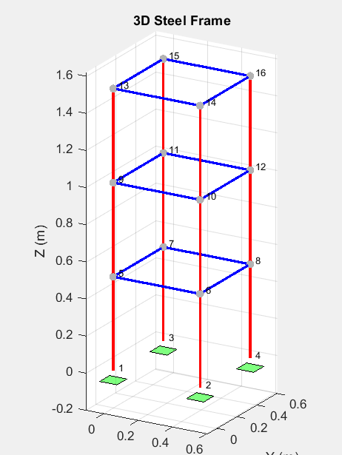
Sanrachna Prahari Pvt Ltd (An IIT Delhi Company)
PROJECT NAME
SENSOR N
PROJECT LOCATION
TEMPERATURE/HUMIDITY
NOTE: MAY BE MORE THAN 4 BOX ARE NEEDED

Slide 9
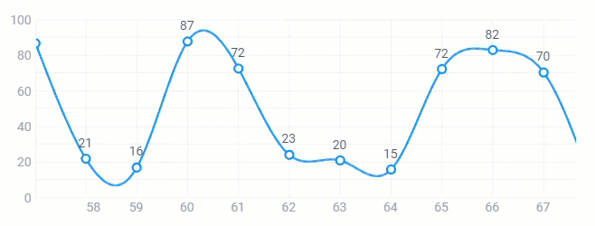
Sanrachna Prahari Pvt Ltd (An IIT Delhi Company)
08/03/2025
SENSOR N
ACTIVE/DEACTIVE
OR (Active/Inactive) as Drop list

Slide 10

Sanrachna Prahari Pvt Ltd (An IIT Delhi Company)
SCAN THE QR CODE FOR CSV FILE

Slide 11
Sanrachna Prahari Pvt. Ltd
Thank You!
Col Rohit Gogna
CEO, Sanrachna Prahari Pvt Ltd
+91-9119126969
Dr Shipra Prakash
Dir Ops, Sanrachna Prahari Pvt Ltd
+91-9319352890
Connect with us on LinkedIn
www.spplindia.org

